Slide 1
CMSC204
Kartchner
V(StateGraph) = {Oregon, Alaska, Texas, Hawaii, Vermont, NewYork, California}
E(StateGraph) = {(Alaska, Oregon), (Hawaii, Alaska), (Hawaii, Texas), (Texas, Hawaii), (Hawaii, California), (Hawaii, New York), (Texas, Vermont), (Vermont, California), (Vermont, Alaska)}
1. Draw the StateGraph
Vermont
Alaska
Texas
Hawaii
Oregon
NewYork
California

Slide 2
a. Show the adjacency matrix that would describe the edges in the graph. Store the vertices in alphabetical order
States
Alaska | California | Hawaii | NewYork | Oregon | Texas | Vermont
0 | 0 | 0 | 0 | 1 | 0 | 0
0 | 0 | 0 | 0 | 0 | 0 | 0
1 | 1 | 0 | 1 | 0 | 1 | 0
0 | 0 | 0 | 0 | 0 | 0 | 0
0 | 0 | 0 | 0 | 0 | 0 | 0
0 | 0 | 1 | 0 | 0 | 0 | 1
1 | 1 | 0 | 0 | 0 | 0 | 0
Alaska
California
Hawaii
NewYork
Oregon
Texas
Vermont,
3. b. Show the adjacency lists
that would describe the edges in the graph
Alaska
Oregon
California
Hawaii
Alaska
California
NewYork
Texas
NewYork
Oregon
Texas
Hawaii
Vermont
Vermont
Alaska
California

Slide 3
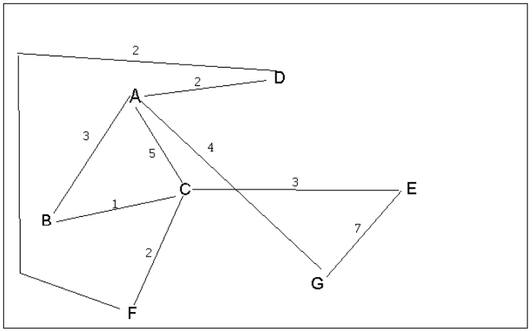
4 a. Which of the following lists the graph nodes in depth first order beginning with E?
A) E, G, F, C, D, B, A
B) G, A, E, C, B, F, D
C) E, G, A, D, F, C, B
D) E, C, F, B, A, D, G
Answer: C
4 b. Which of the following lists the graph nodes in breadth first order beginning at F?
A) F, C, D, A, B, E, G
B) F, D, C, A, B, C, G
C) F, C, D, B, G, A, E
D) a, b, and c are all breadth first traversals
Answer: A

Slide 4
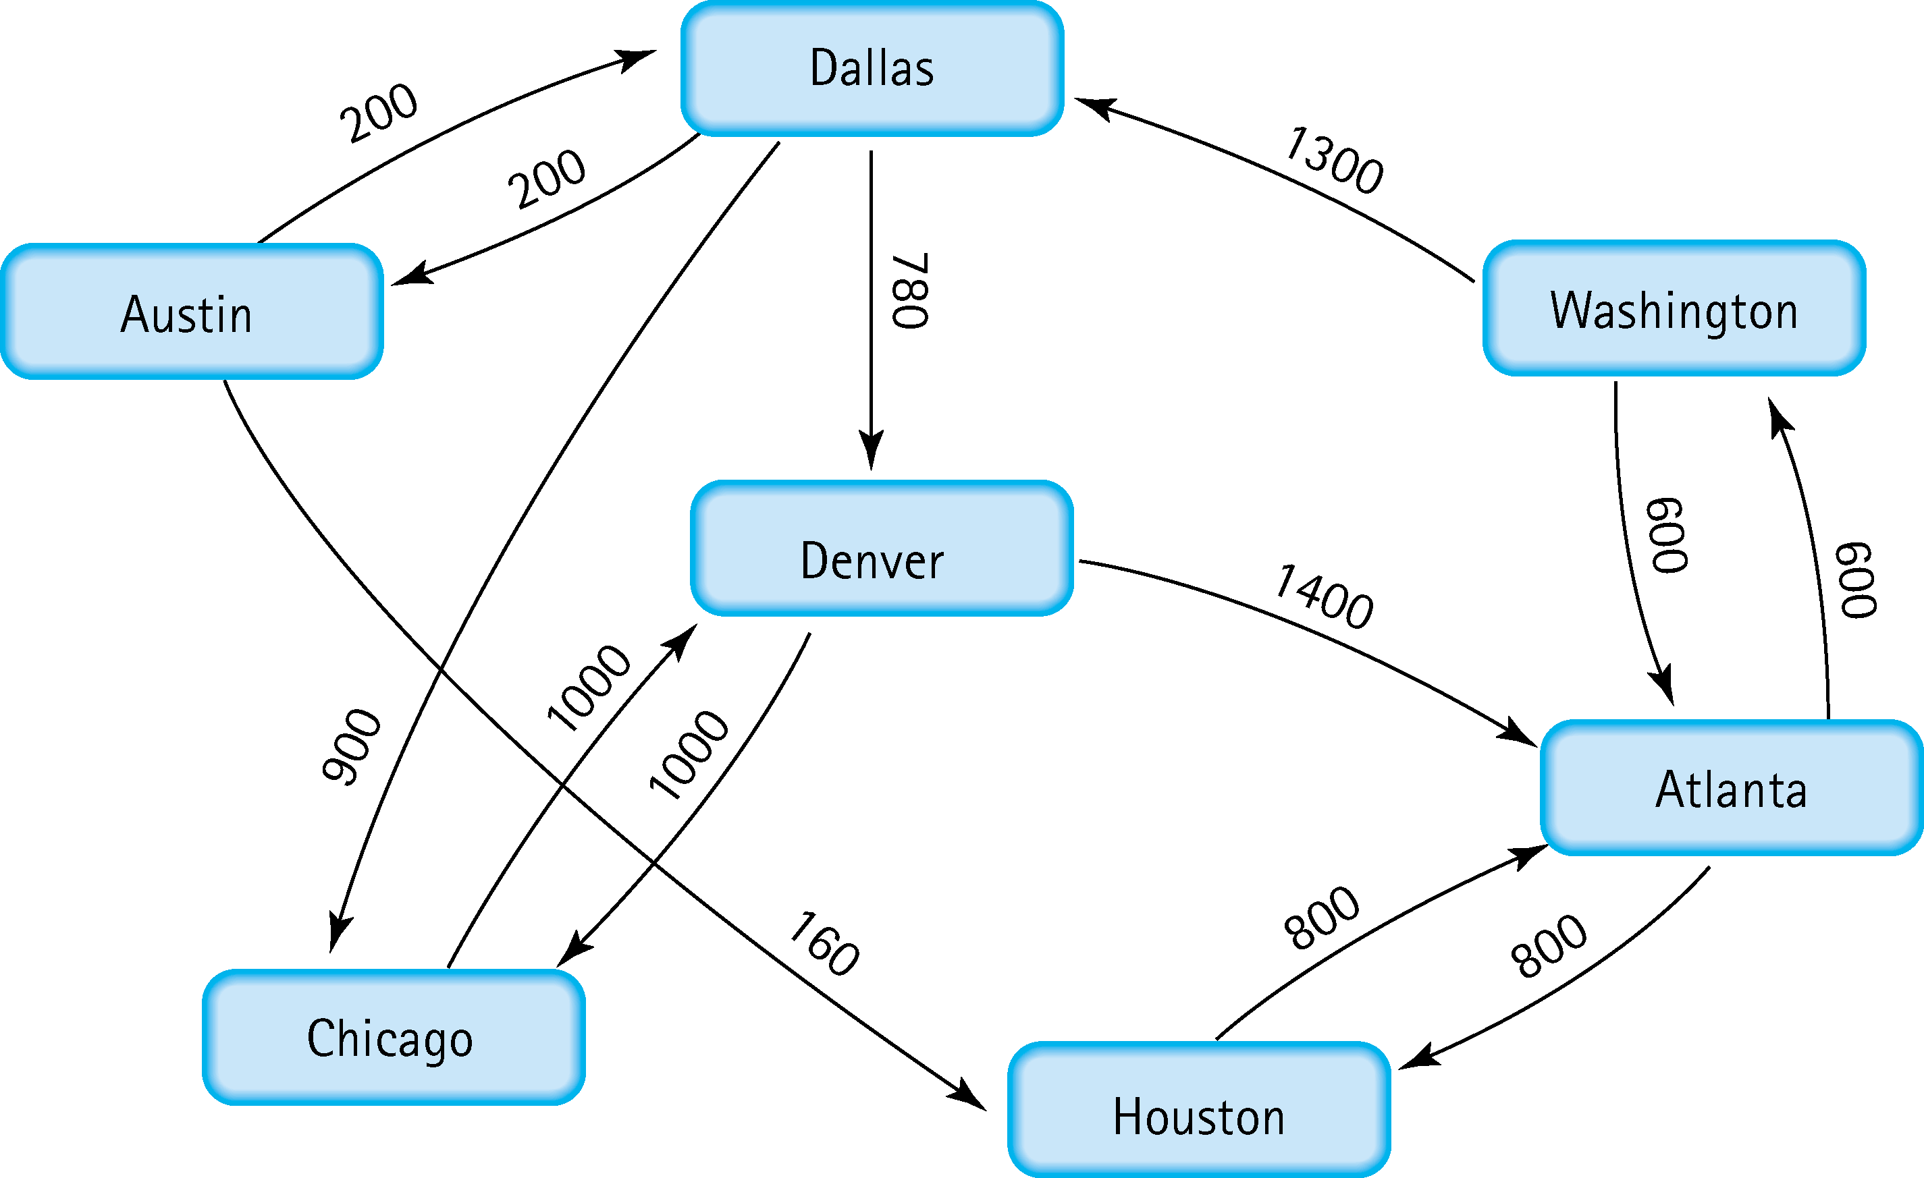
5. Find the shortest distance from Atlanta to every other city
Atlanta to Houston: 800
Atlanta to Washington: 600
Atlanta to Dallas: 1900
Atlanta to Denver: 2680
Atlanta to Chicago: 2800
Atlanta to Austin: 2100

Slide 5
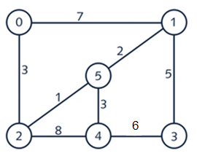
6. Find the minimal spanning tree using Prim’s algorithm. Use
0 as the source vertex . Show the steps.
Step 1:
0
Step 2:
0
3
3
1
5
2
2
Minimum is 3
Minimum is 1
Step 3:
0
2
1
Step 4:
0
2
1
3
1
5
3
5
2
1
3
2
4
Minimum is 2
Minimum is 3
Step 5:
0
2
1
3
5
5
2
1
3
4
3
Minimum is 5

Slide 6
7. Find the minimal spanning tree using Kruskal’s algorithm.
Show the weights in order and the steps.
Sorted List (1,2,3,3,5,6,7,8)
Step 1:
0
1
Step 2:
0
2
1
5
5
1
1
2
4
3
2
4
3
Step 3:
0
1
Step 4:
2
0
2
1
3
5
3
5
1
1
3
2
4
3
2
4
3
Step 5:
0
1
2
3
5
5
1
3
2
4
3

Slide 7
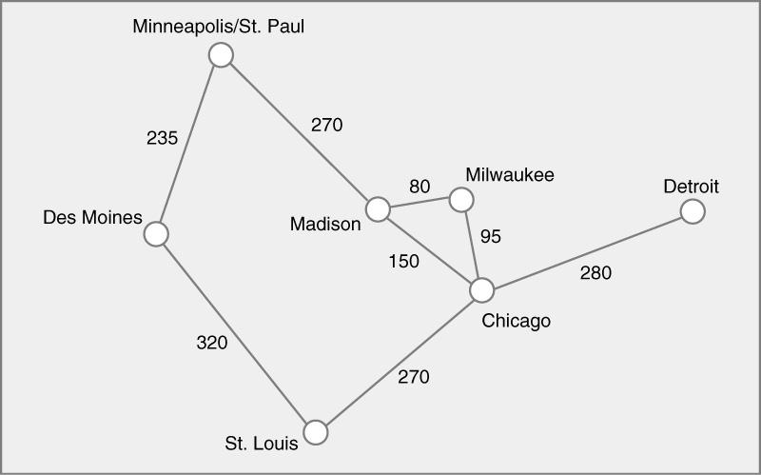
8. Find the minimal spanning tree using the algorithm you prefer. Use
Minneapolis/St. Paul as the source vertex
270
80
235
95
280
270
235 + 270 + 80 + 95 + 280 + 270 = 1230

Slide 8
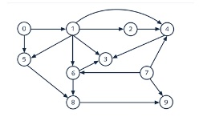
9. List the nodes of the graph in a breadth first topological ordering. Show the
steps using arrays predCount, topologicalOrder and a queue
0 | 1 | 2 | 3 | 4 | 5 | 6 | 7 | 8 | 9
Node
Step 1: find indegree of all vertices
Step 2: push all nodes with indegree = 0 into queue.
Queue: 0 7
PredCount:
Topological order: 0
Step 3: push 1 into queue
queue: 0 7 1
predCount: 1 2
topological order: 0 7
Step 4: queue: 0 7 1
predCount: 0 1 2
topological order: 0 7 1
Step 5: push node 5 and node 6 to queue
queue: 0 7 1 5 6
predCount: 0 1 2 3
topological order: 0 7 1 5
delete node 6 and add to topological order
queue 0 7 1 5 6
predCount: 0 1 2 3 4
topological order: 0 7 1 5 6
Step 6: push all nodes with indegree 1 to the queue
queue: 0 7 1 5 6 2 3 8 9
predCount: 0 1 2 3 4 5
topological order: 0 7 1 5 6 2
Step 7: push nodes 4 to queue
queue: 0 7 1 5 6 2 3 8 9 4
predCount: 0 1 2 3 4 5 6
topological order: 0 7 1 5 6 2 3
Step 8: delete node 8 and add to topological order
queue: 0 7 1 5 6 2 3 8 9 4
predCount: 0 1 2 3 4 5 6 7
topological order: 0 7 1 5 6 2 3 8
Step 9: delete node 9 and node 4 and add them to topological order
queue: 0 7 1 5 6 2 3 8 9 4
predCount: : 0 1 2 3 4 5 6 7 8 9
topological order: 0 7 1 5 6 2 3 8 9 4
0 | 1 | 1 | 3 | 3 | 2 | 2 | 0 | 2 | 2
0 | 1 | 1 | 3 | 3 | 2 | 2 | 0 | 2 | 2
Decrement indegree[1] and indegree[5] by 1
0 | 0 | 1 | 3 | 3 | 1 | 2 | 0 | 2 | 2
Decrement indegree[6], indegree[9], indegree[4] by 1
0 | 0 | 1 | 3 | 2 | 1 | 1 | 0 | 2 | 1
Decrement indegree[6], indegree[5], indegree[3] by 1
0 | 0 | 1 | 2 | 2 | 0 | 0 | 0 | 2 | 1
Decrement indegree[3], indegree[8] by 1
0 | 0 | 1 | 1 | 2 | 0 | 0 | 0 | 1 | 1
Decrement indegree[4] by 1
0 | 0 | 1 | 1 | 1 | 0 | 0 | 0 | 1 | 1
0 | 0 | 1 | 1 | 1 | 0 | 0 | 0 | 1 | 1

Slide 9
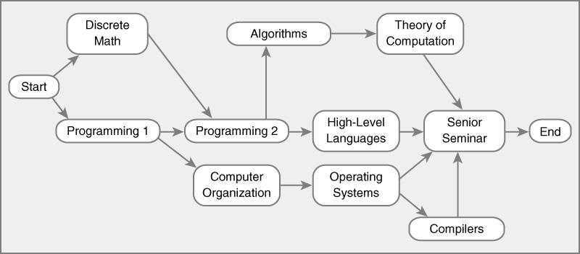
10. List the nodes of the graph in a breadth first topological ordering.
Start, Discrete Math, Programming 1, Programming 2, Computer Organization, Algorithms, High-Level Languages, Operating Systems, Theory Computation, Senior Seminar, Compilers, End

